Slide 1
UNIT 15 – Object oriented programming
With ben read

Slide 2
Aims & objectives
Analyse the use of Pointers in C/C++
Discuss methods of usage, null pointers, arithmetic and arrays
Review the week’s techniques via a self-paced tutorial

Slide 3
pointers
C++ pointers are easy and fun to learn. Some C++ tasks are performed more easily with pointers, and other C++ tasks, such as dynamic memory allocation, cannot be performed without them.
As you know, every variable is a memory location and every memory location has a specific address. These addresses can be accessed using the reference (&) operator.

Slide 4
pointers
This code will print the address of the variables, rather than their values. Which address do you think will be output for var2? −
#include <iostream>
using namespace std;
int main ()
{
int var1;
char var2[10];
cout << "Address of var1 variable: ";
cout << &var1 << endl;
cout << "Address of var2 variable: ";
cout << &var2 << endl;
return 0;
}

Slide 5
What are pointers?
A pointer is a variable whose value is the memory address of another variable. Like any variable or constant, you must declare a pointer before you can work with it. The general form of a pointer variable declaration is −
type *variable_name
Here, type is the pointer's base datatype; it must be a valid C++ datatype and variable_name is the name of the pointer variable. The asterisk you use to declare a pointer is the same asterisk that you use for multiplication. However, in this statement the asterisk is being used to designate a variable as a pointer.

Slide 6
What are pointers?
The following are valid pointer declarations –
int *ipoint; // pointer to an integer
double *dpoint; // pointer to a double
float *fpoint; // pointer to a float
char *chpoint // pointer to character
The actual datatype of the value of all pointers, whether integer, float, character, or otherwise, is the same; a long hexadecimal number that represents a memory address, e.g. 0xbfebd5c0
The only difference between pointers of different data types is the data type of the variable or constant that the pointer points to. If a pointer is only pointing to a memory address, why do you think it needs a datatype?

Slide 7
Using pointers in c++
There are a few important operations which we will do with pointers very frequently –
Define a pointer variable, e.g. int *ip;
Assign the address of a variable to a pointer, e.g. ip = &var;
Access the value stored at the address the pointer variable is pointing to. This is done using the unary, or dereference (*) operator, e.g. cout << *ip << endl;

Slide 8

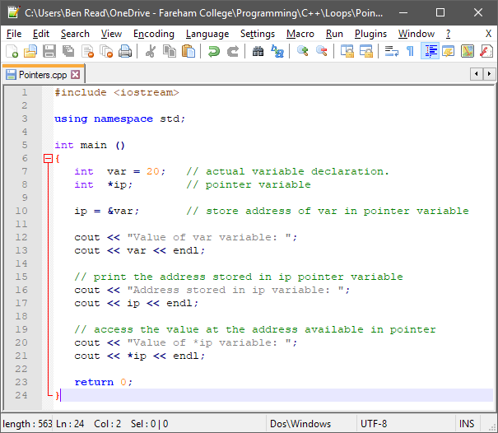
Using pointers in c++
When this code is compiled and executed, it produces −
Value of var variable: 20
Address stored in ip variable: 0xbfc601ac
Value of *ip variable: 20

Slide 9
Null pointers
It is always a good practice to assign the pointer NULL to a pointer variable in case you do not have an exact address to be assigned. This is done at the time of variable declaration. A pointer that is assigned NULL is called a null pointer.
The NULL pointer is a constant with a value of zero defined in several standard libraries, including iostream.

Slide 10
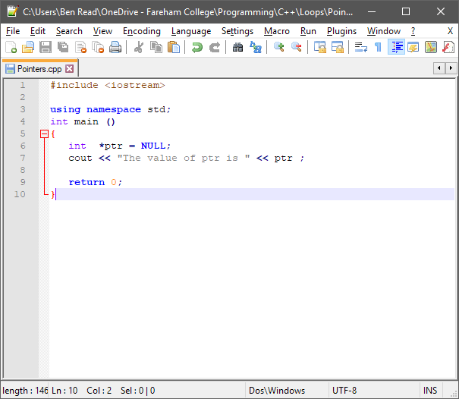
Null pointers
When this code is compiled and executed, it produces −
The value of ptr is 0

Slide 11
Null pointers
On most operating systems, programs are not permitted to access memory at address 0. That memory address is reserved by the operating system. However, the memory address 0 has special significance; it signals that the pointer is not intended to point to an accessible memory location. By convention, if a pointer contains the NULL (zero) value, it is assumed to point to nothing.
To check for a null pointer you can use an if statement as follows −
if(ptr) // succeeds if p is not null
if(!ptr) // succeeds if p is null
If all unused pointers are given the NULL value, you can avoid the accidental misuse of an uninitialized pointer. Uninitialised variables hold random values and can make it difficult to debug the program.

Slide 12
Pointer arithmetic
As we’ve seen in previous lessons, memory addresses can hold one byte of data. A pointer has a numeric value, usually that of a memory address. You can perform arithmetic operations on a pointer just as you can on a normal variable. There are four arithmetic operators that can be used on pointers: ++, --, +, and –
To understand pointer arithmetic, let us consider that ptr is an integer pointer which points to the address 1000. Assuming we are using 32 bit integers, made up of 4 bytes, let us perform the following arithmetic operation on the pointer − ptr++
ptr will now point to location 1004, because each time ptr is incremented it will point to the next integer. This operation will move the pointer to the next memory location without impacting the actual value stored at the memory location. If ptr points to a char whose address is 1000, then the above operation will point to the location 1001. Chars are 8 bits, or one byte.

Slide 13
Incrementing pointers
In the previous unit we did a lot of work using arrays. Arrays are CONSTANT pointers. When they are declared they are assigned a number of memory addresses equal to the number and size of their elements. The declared array name ‘points’ to the first element, zero.
Because arrays are constants they cannot be incremented However, normal pointers can move and this makes them very useful for operations such as interrogating the contents of an array
The following program increments a pointer to access each succeeding element of the array -

Slide 14
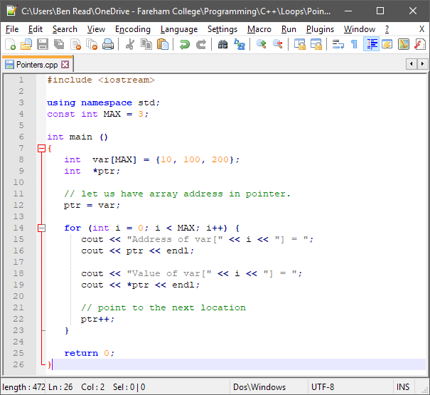
incrementing pointers
When this code is compiled and executed, it produces −
Address of var[0] = 0xbfa088b0
Value of var[0] = 10
Address of var[1] = 0xbfa088b4
Value of var[1] = 100
Address of var[2] = 0xbfa088b8
Value of var[2] = 200

Slide 15
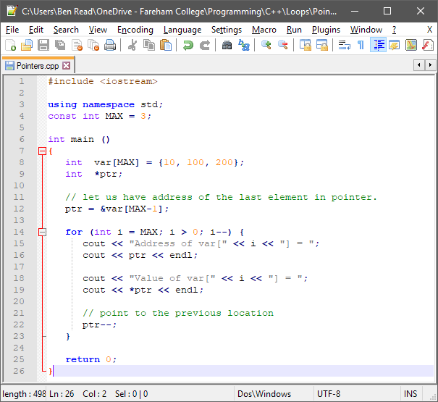
decrementing pointers
When this code is compiled and executed, it produces −
Address of var[3] = 0xbfdb70f8
Value of var[3] = 200
Address of var[2] = 0xbfdb70f4
Value of var[2] = 100
Address of var[1] = 0xbfdb70f0
Value of var[1] = 10

Slide 16
Comparing pointers
Pointers may be compared using relational operators such as ==, <, and >. If two pointers point to variables that are related to each other, such as elements of the same array, then they can be meaningfully compared.
The following program modifies the previous example by incrementing the variable pointer so long as the address to which it points is either less than or equal to the address of the last element of the array, which is &var[MAX-1]

Slide 17
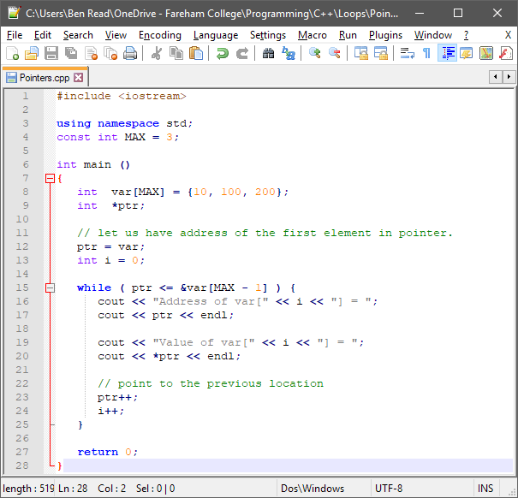
comparing pointers
When this code is compiled and executed, it produces −
Address of var[0] = 0xbfce42d0
Value of var[0] = 10
Address of var[1] = 0xbfce42d4
Value of var[1] = 100
Address of var[2] = 0xbfce42d8
Value of var[2] = 200

Slide 18
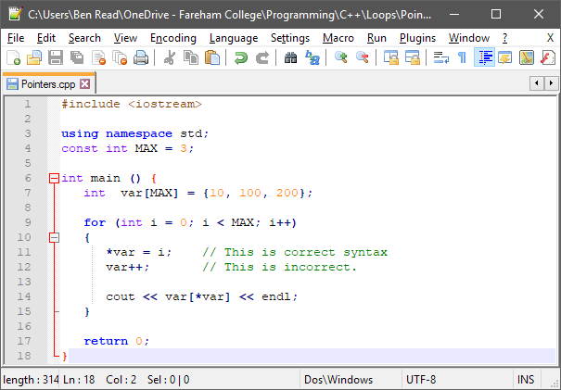
Pointers to arrays
When this code is compiled and executed, it produces −
0
100
200

Slide 19
Pointers to arrays
It is perfectly acceptable to apply the pointer operator * to var but it is illegal to modify var’s value. This is because var is a CONSTANT that points to the beginning of an array and can not be altered.
By applying a pointer to the array’s existing pointer we are able to alter the focus element from the default of 0 and even the value of the element being inspected. This is called ‘pointer to pointer’ and will be covered in the next class.
Because an array name generates a pointer constant it can still be used in pointer-style expressions, as long as it is not modified. For example, the following is a valid statement that assigns var[2] the value 500 −
*(var + 2) = 500;
The above statement is valid and will compile successfully because var has not been changed.

